Slide 1

WELCOME
exercise
Real-life corporate pipeline
next
demo
challenges
forces
about
DESIGNED BY LEO MATTOS
Notes:
Welcome all for this exercise review. Thank you all first of all for giving me the opportunity to reflect and present to you around a topic I like so much.

Slide 2





MESSAGE FROM
next
demo
exercise
challenges
forces
about
LEO MATTOS
Technical Coach
Developer
Soccer coach
Adventurer
IT Services
Principal Consultant
20+ years
In the industry
Licensed for kids
U10 - U16
Meyers Briggs
abbreviated test
Notes:
I will start by describing you the main carachter of this tale : Leo Mattos. I am and adventurer, that got his passion to coach and lead teams on behavior modeling or changing when I started to work more serious as soccer coach as hobbie. Similarly on my many years of playing and watching soccer, I have over 20 years in the industry, always close to development. On one the highest point, for me, is that I know how is to be in the “other side”, on the developer shoes with all pressure of big companies and pressure to deliver. And I all my Lean DevOps experiments, started with the desired ( or it would be a need ) to never come back to that situation.
Adventurer : Strenghts
Passionate – Beneath Adventurers’ quiet shyness beats an intensely feeling heart. When people with this personality type are caught up in something exciting and interesting, they can leave everything else in the dust. Curious – Ideas are well and good, but Adventurers need to see and explore for themselves whether their ideas ring true. Work revolving around the sciences may seem a poor match for their traits, but a boldly artistic and humanistic vision is often exactly what research needs to move forward – if Adventurers are given the freedom they need to do so. Artistic – Adventurers are able to show their creativity in tangible ways and with stunning beauty. Whether writing a song, painting an emotion, or presenting a statistic in a graph, Adventurers have a way of visualizing things that resonates with their audience.
Weeknesses :
Fiercely Independent – Freedom of expression is often Adventurers’ top priority. Anything that interferes with that, like traditions and hard rules, creates a sense of oppression for Adventurer personalities. This can make more rigidly structured academics and work a challenge. Unpredictable – Adventurers’ dislike long-term commitments and plans. The tendency to actively avoid planning for the future can cause strain in Adventurers’ romantic relationships and financial hardship later in life.

Slide 3
Goal:
Describe real-life end to end delivery pipeline
Communicate often
next
demo
exercise
challenges
forces
about
Commit to a feasible goal
Frame the problem
Deliver results that tells my story
Be sure to have something at the end
Experience based
Notes:
And what was the journey of our hero? The mission as I took it was to use the hero’s background and real life experiences on different business and domains, to describe how an end to end delivery pipeline would look like representing the values behind the 3 ways of devops and putting them in practice. And the journey started by framing the problem and comiting to a clear goal, passing by support of Constance communication with the council, and finalizing in the results through the valley of MVP concept. I took the journey as an opportunity to demonstrate a summary of what kind of pipelines I have seem working on most generic cases.

Slide 4
Forces
Driving Forces
Restraining Forces
4
3
2
1
1
2
3
4
Experience on regulated envs
Real scenario
Experience with different tech footprint
Decision:
Focus on having the ”right” steps that show my believes and experience
On premise / serviced resources experience
next
demo
exercise
challenges
forces
about
Early feedback
Developer background
Delivery process orchestration
Over design
Time
Total score: 14
Total score: 12
Notes:
And the journey was not an easy one, with many forces battling to push back and forward our hero. To deal with the restraining force to build a realistic scenario, our hero came with his experience on regulated envs to balance it. And then our hero’s background on devOps to not come as infrastructure engineer but as a developer, got together with the timed boxed situation to create trouble, but our hero’s experience with different tech footprint, allied with the Jenkins features to orchestrate the pipeline and be the focal point took care of this tread. Finally, the design of different feedback cycles, backed up by early feedback principle finalized the battles, avoiding the temptation of over design and try to show off. And a realistic, yet completed pipelines, raised giving light and prosperity to all.
Decision also to write the steps that I believe need to be there, not limiting for which I know how to do for sure. The concern on the design of the steps was to give something realistic, more than just novelty or concerned about showing my skills. My focus was on real life

Slide 5
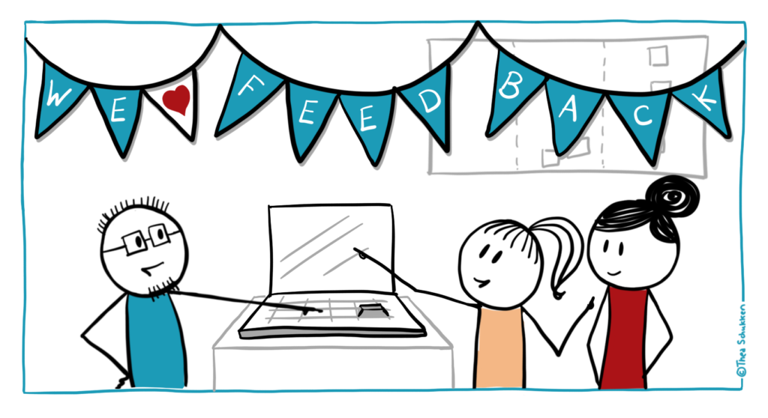
Pipeline demo
next
demo
exercise
challenges
forces
about
Notes:
And here is the final product.

Slide 6

Some rocks on the way
Lack of Vagrant Knowledge
01
Specially on the configuration
Jenkins - Access to external resources
02
next
demo
exercise
Even being able to access from host and have the right password, had issues making Jenkins access external resources
challenges
forces
about
Focus on solution
03
Themes
Planned to do too much. Risk of not having “anything” at the end
Disk space
04
Just one executor at time by default

Slide 7
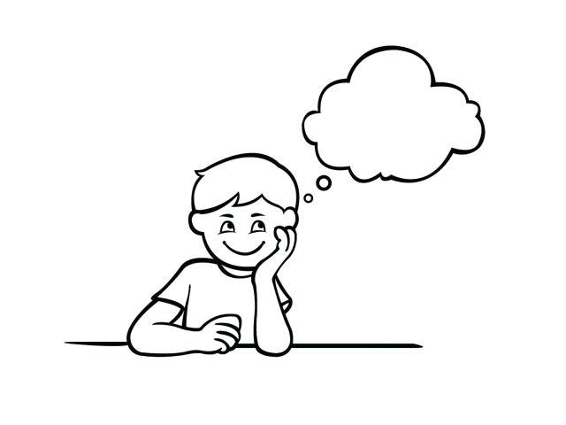
What would come next
Telemetry
01
Stages stats collection and visualization
Tollgates
02
next
history
services
teams
Control points with minimum standard for quality and audit
timeline
about
If I had the time….
Self provision
03
Configure the self provision of servers and services to be used by pipeline during execution
Improved ChatOps
04
Implement configuration to notify via Slack all the build anomalies
Notes:
What I could do more is the chatops to increase transparency

